Slide 1
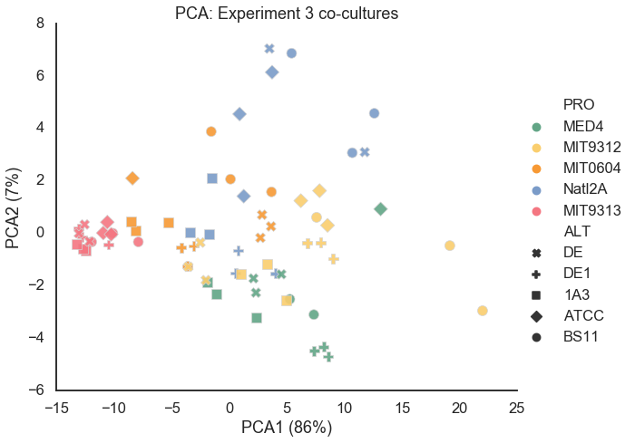
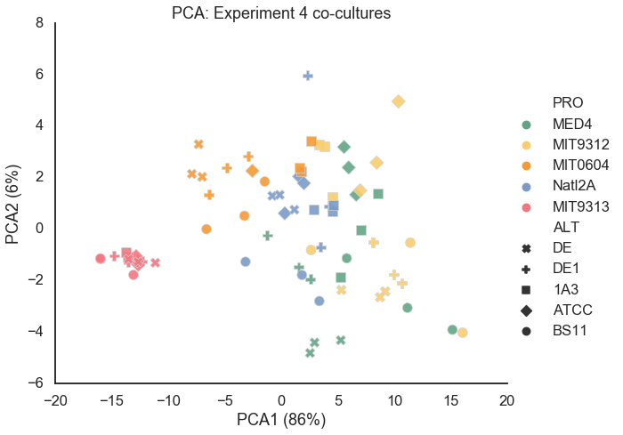
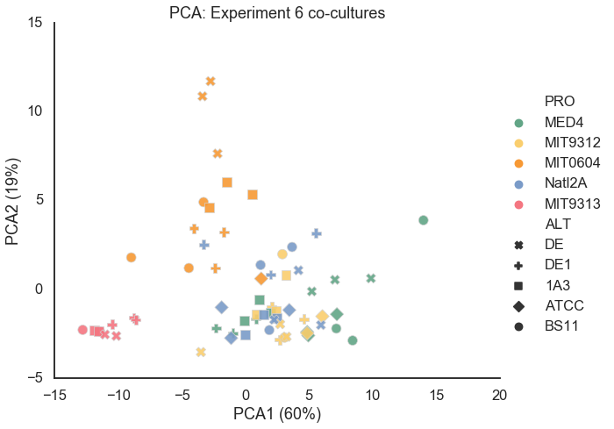
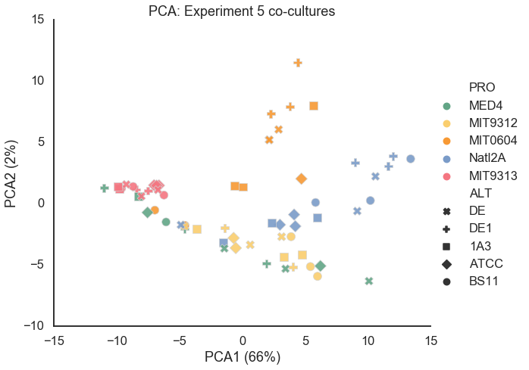
Figure 2 PCA
Add PCA of exp 3,4,5,6 (each one alone) and check if there is also a separation by PRO strains phylogeny (like in exp 1).

Slide 2
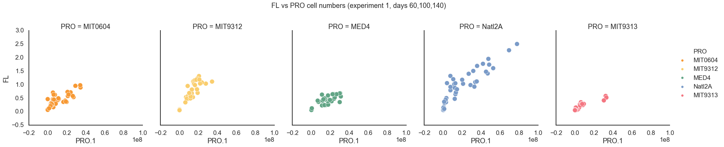
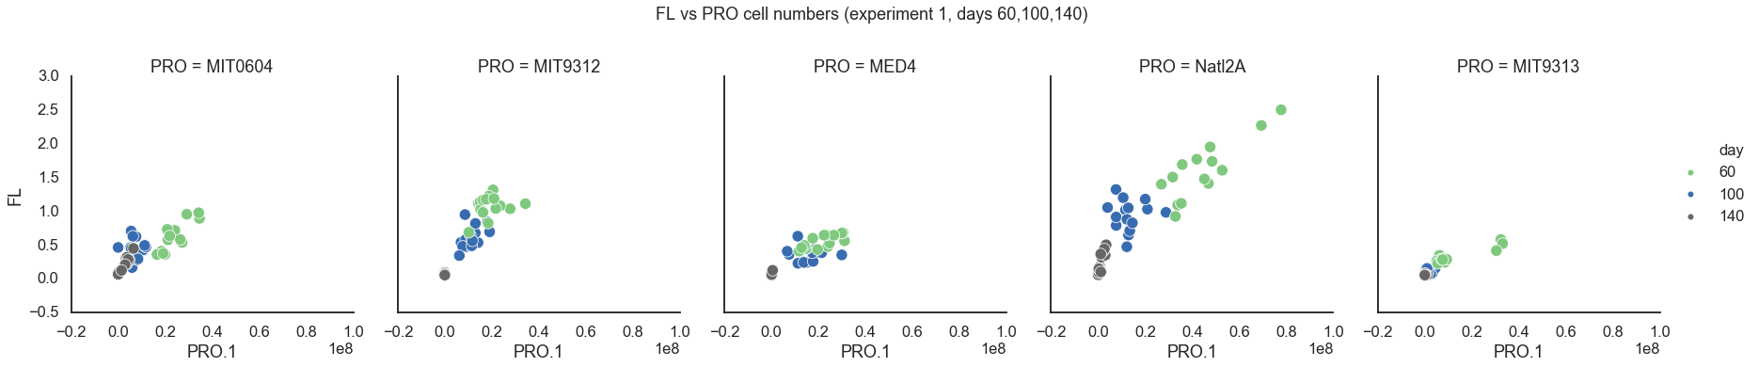
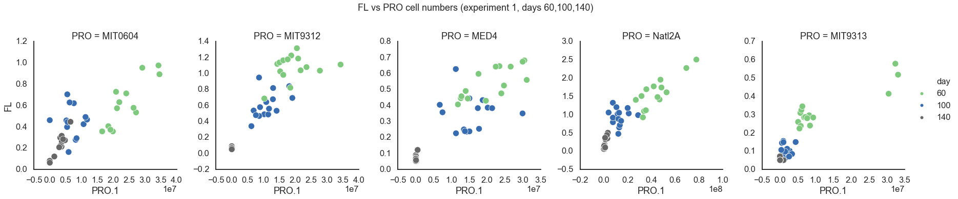
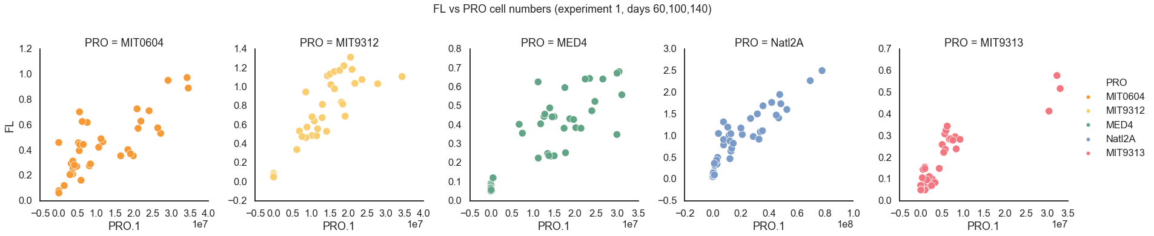
Figure 3 (FCM) Add a figure of FCM count / FL (X/Y) – only dates that both have.

Slide 3
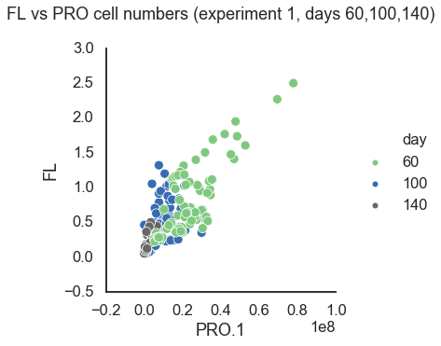
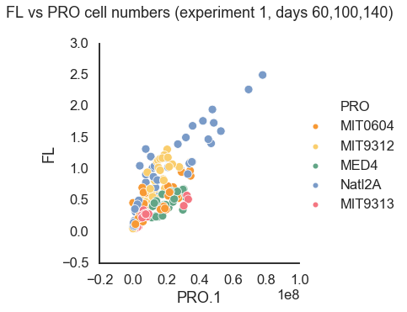
Figure 3 (FCM)
Add a figure of FCM count / FL (X/Y) – only dates that both have.

Slide 4
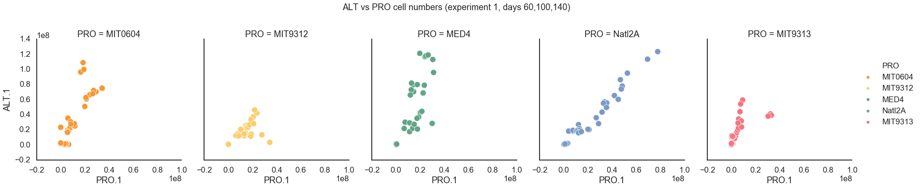
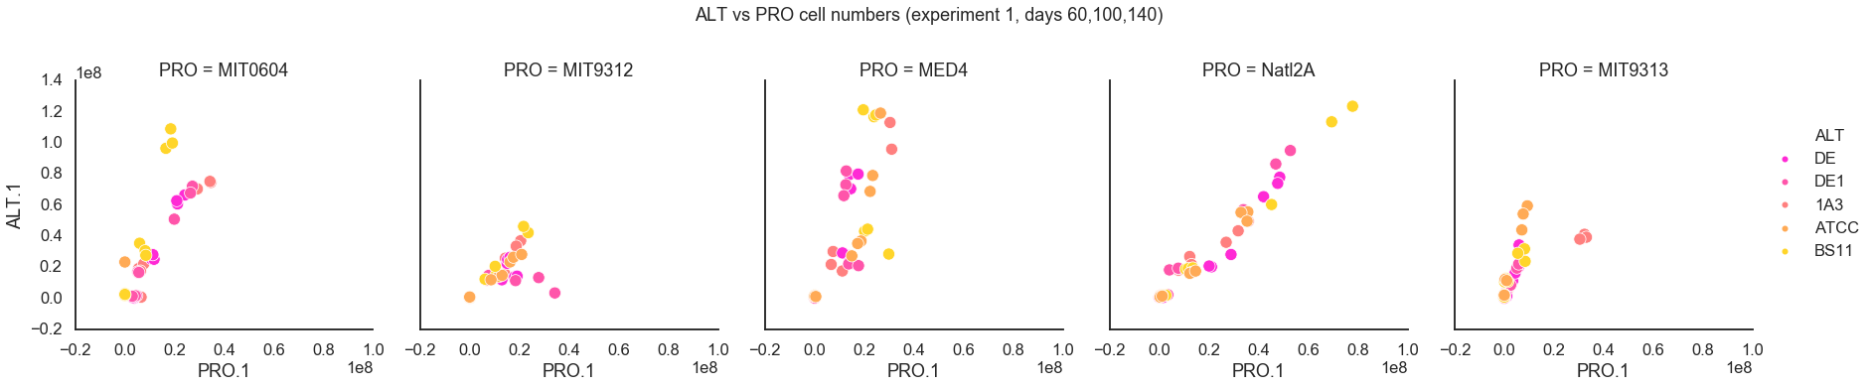
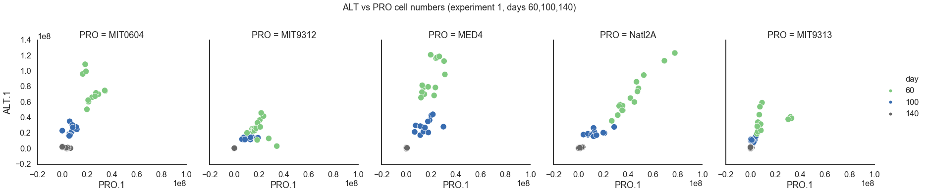
ALT vs PRO cell numbers – experiment 1 - all dates

Slide 5
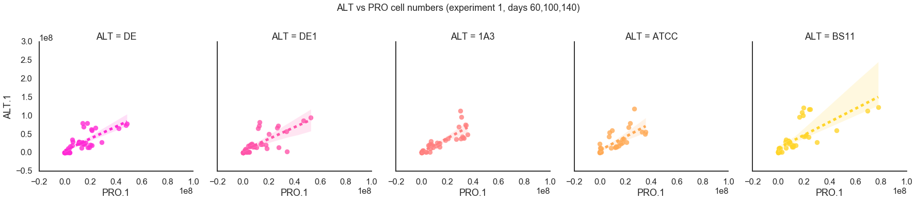
ALT vs PRO – cell numbers – by ALT

Slide 6
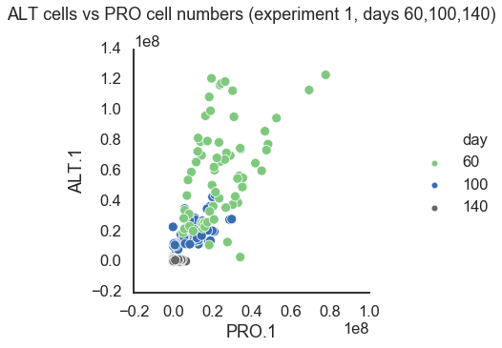

Slide 7
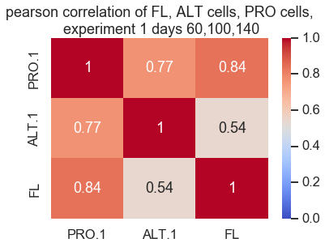
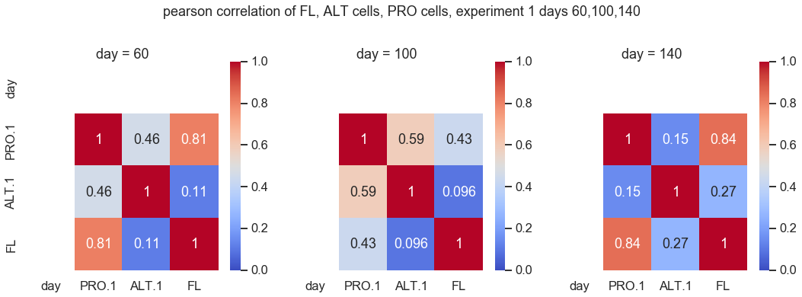
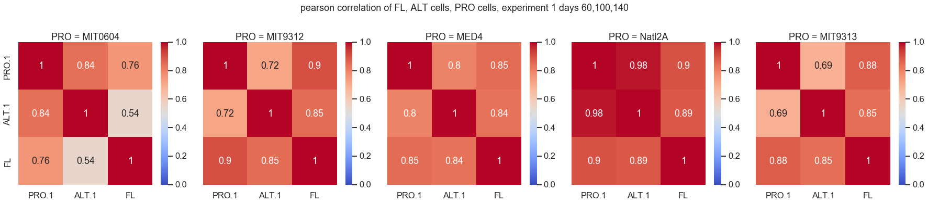
Figure 3 (FCM)
Correlation between FL and FCM at days 60, 100 and 120

Slide 8
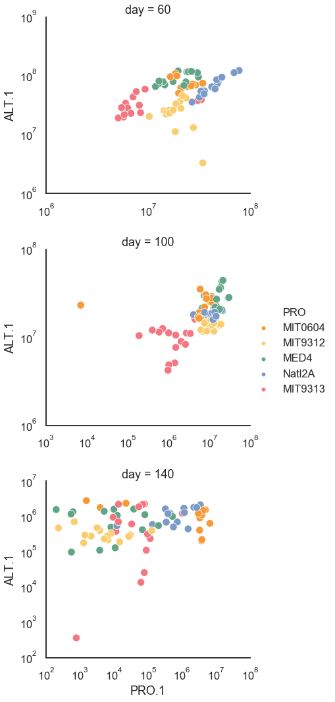
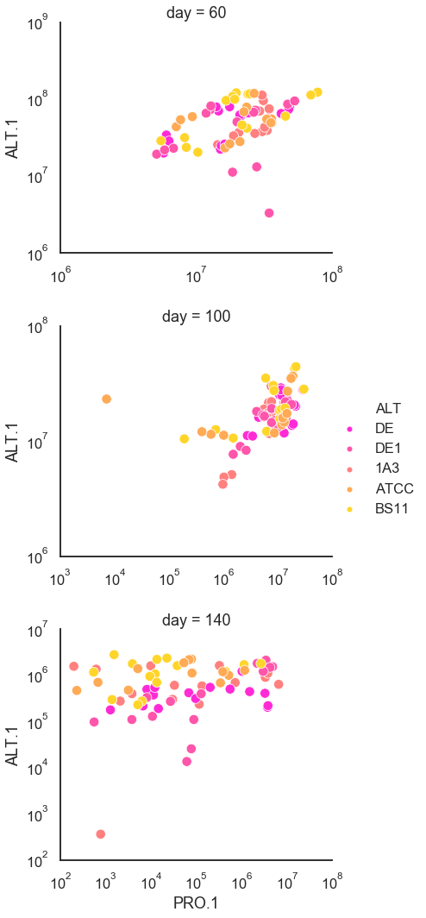
Cell numbers
Experiment 1
ALT vs PRO
Change this figure for exp 1 to PRO and ALT according color (2 panel for each day 60, 100, 120) – add statistic

Slide 9
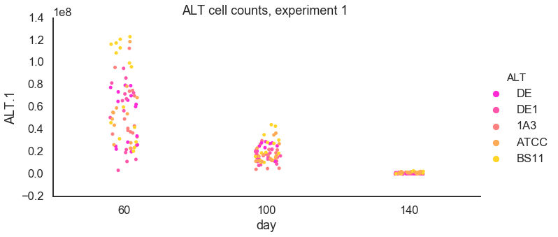
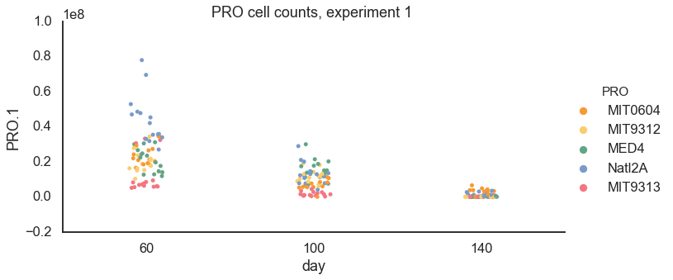
Cell numbers
Experiment 1
ALT vs PRO
Add FCM figure with all ALT or PRO in days 60, 100 and 120.

Slide 10
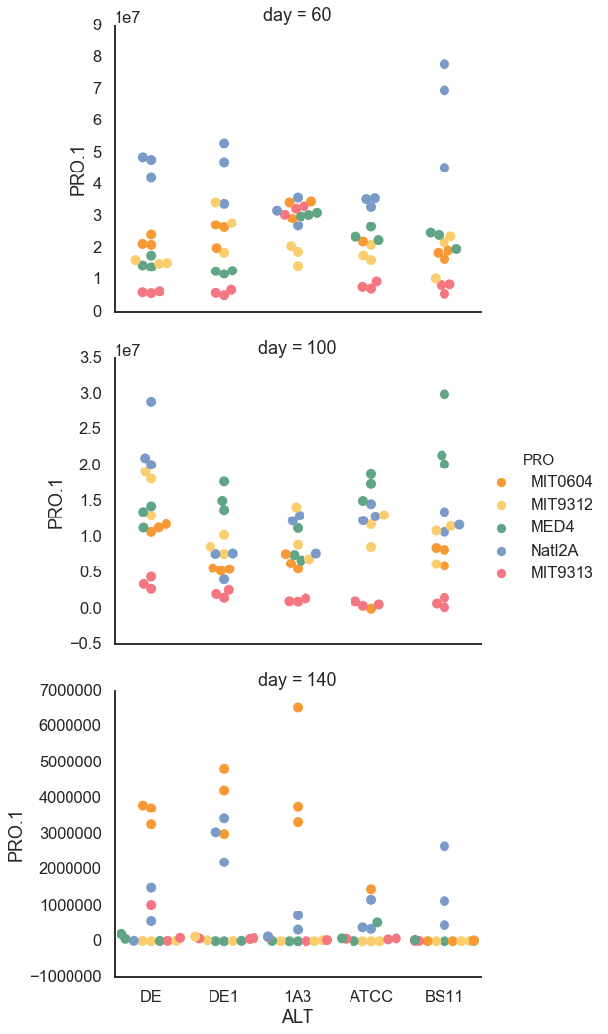
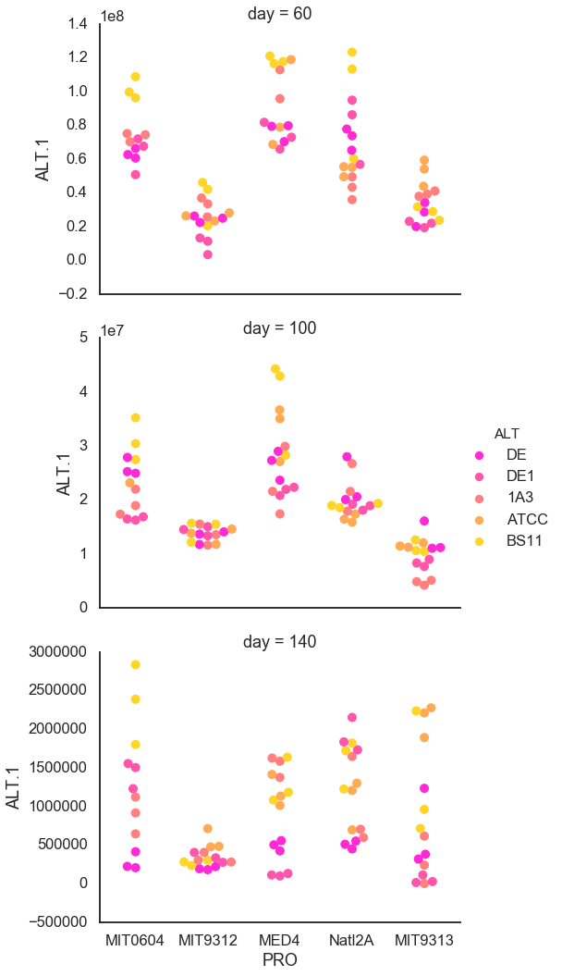
Cell numbers
Experiment 1
ALT vs PRO

Slide 11
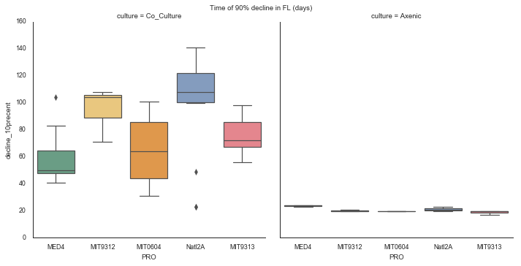
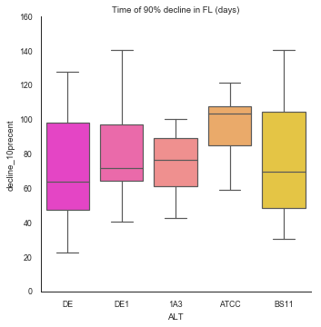
Calculate the death rate of PRO with and without Hets (IN Co-culture and Axenic).
Co-culture reduce the mortality rate!
D-value: The time needed to reduce the bacterial population by 90% or one log10 at a given temperature.

Slide 12
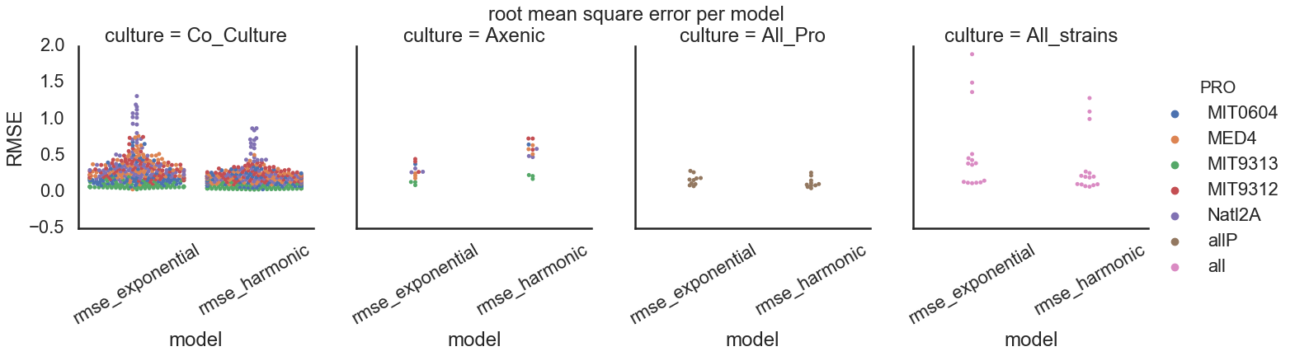
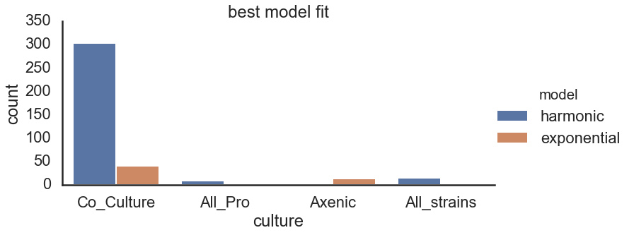
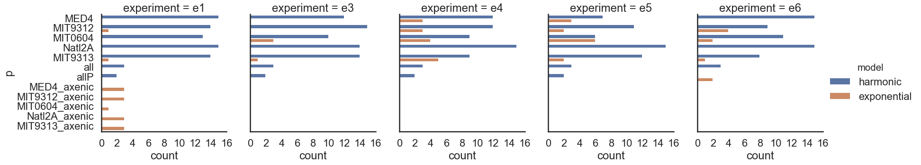

Slide 13
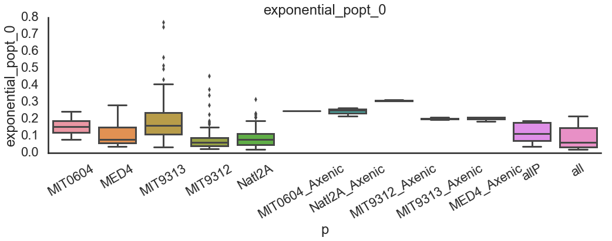
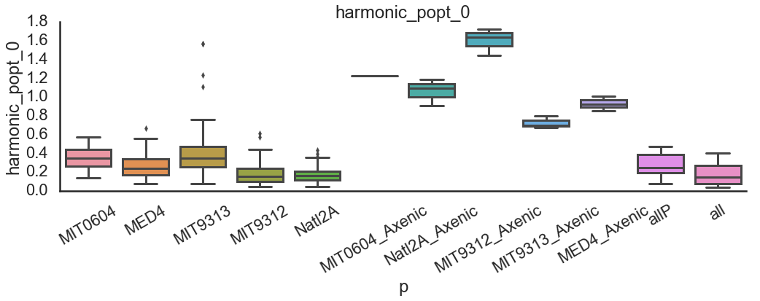
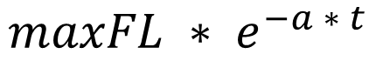
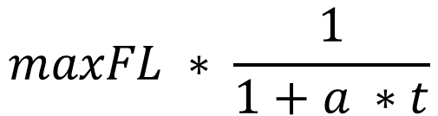
Exponential:
$$maxFL ∗ e^{−a ∗ t}$$
Harmonic:
$$maxFL ∗ \frac{1}{1+a ∗t}$$

Slide 14
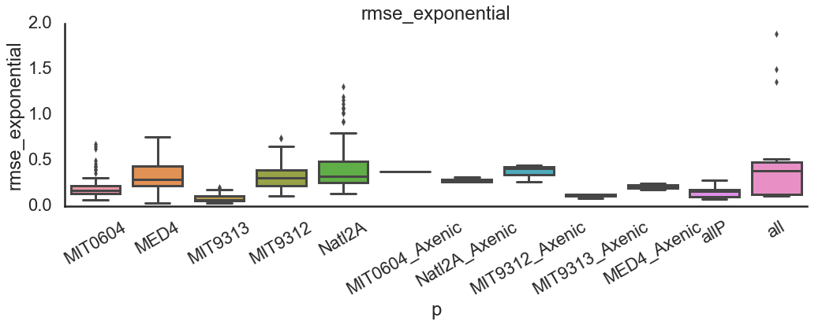
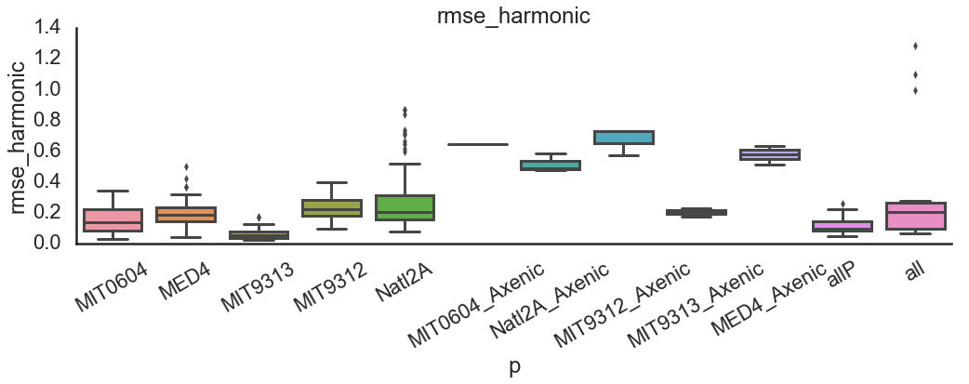
RMSE = root mean square error

Slide 15
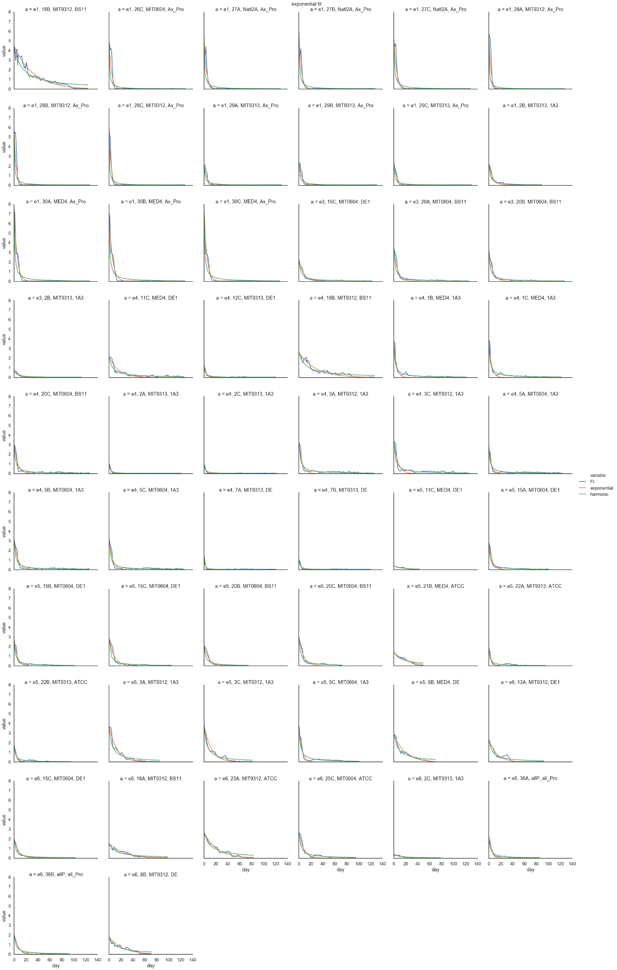
Samples where exponential fits better

Slide 16
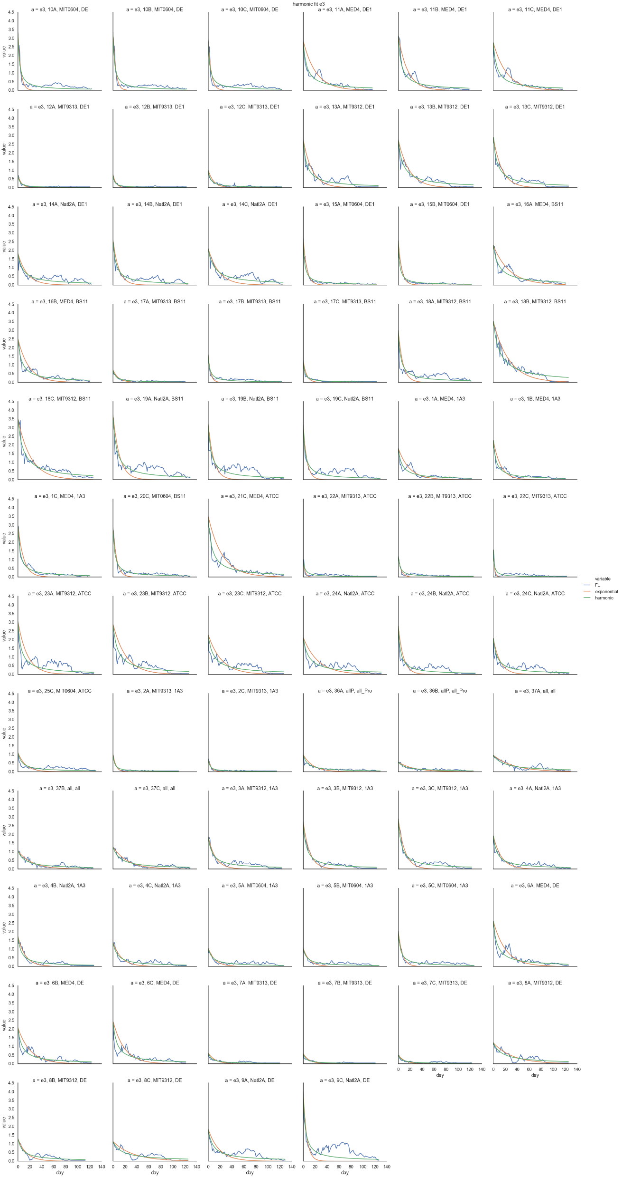
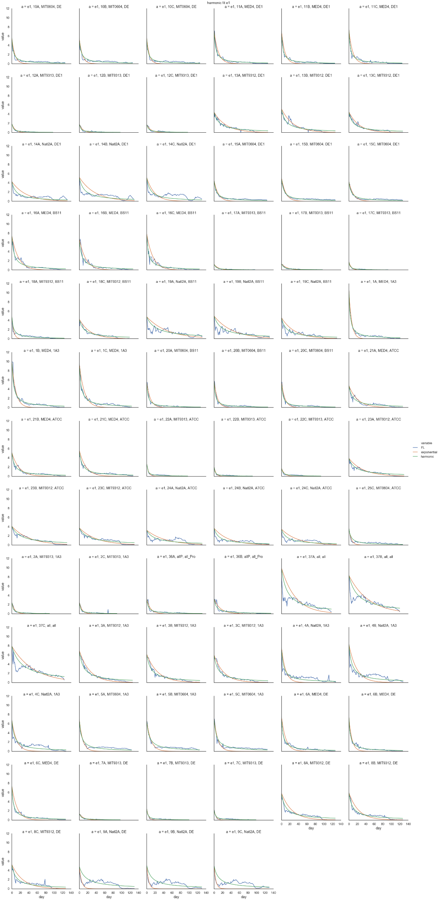
Samples where harmonic fits better

Slide 17
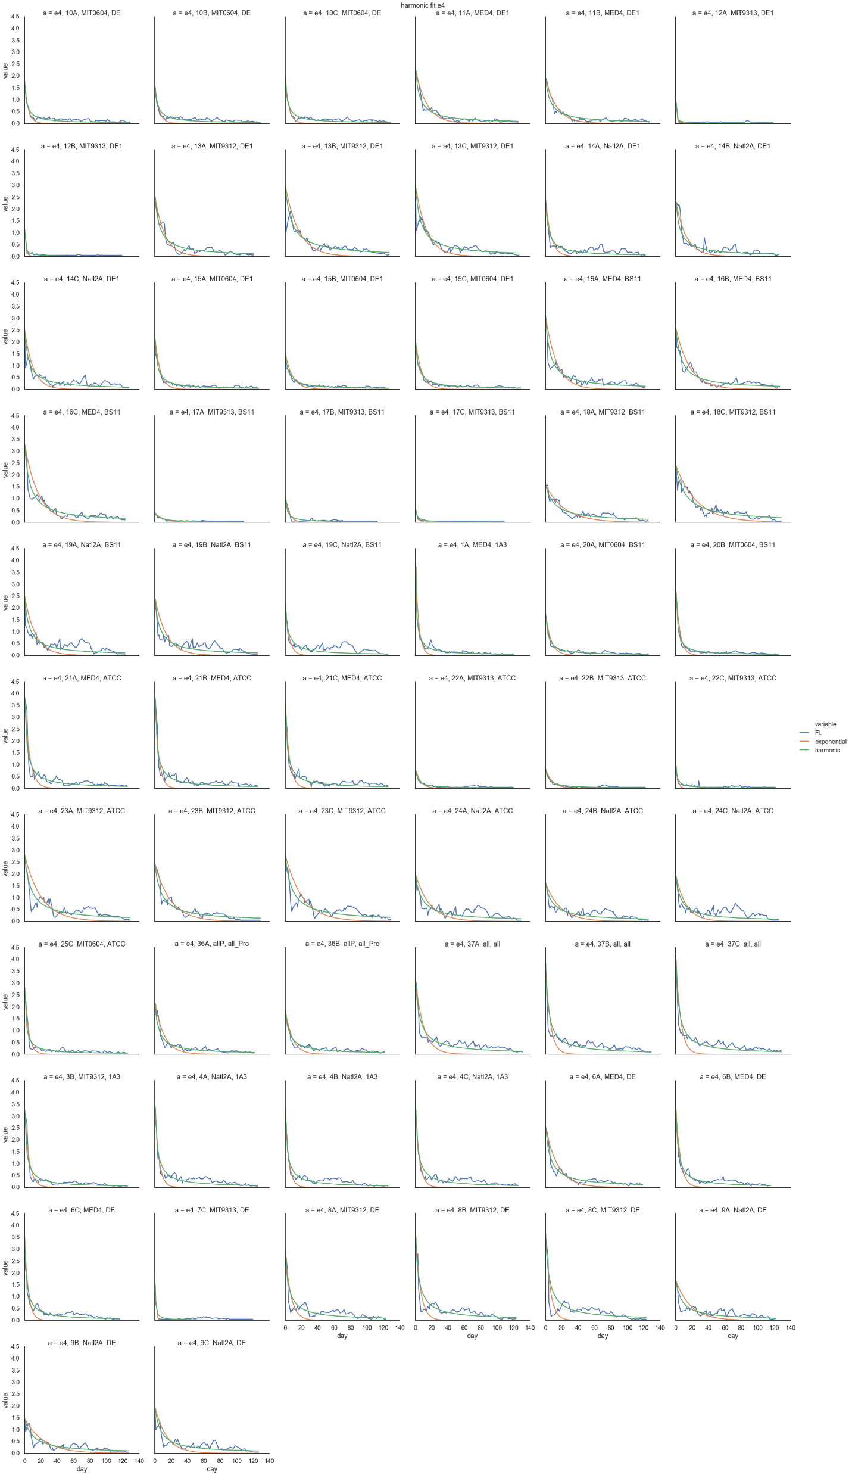
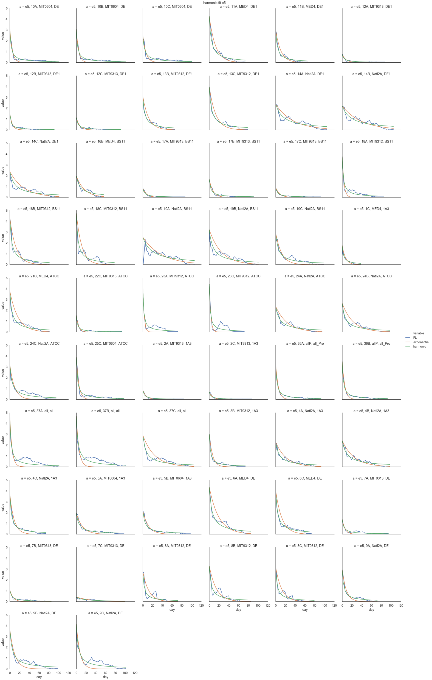
Samples where harmonic fits better

Slide 18
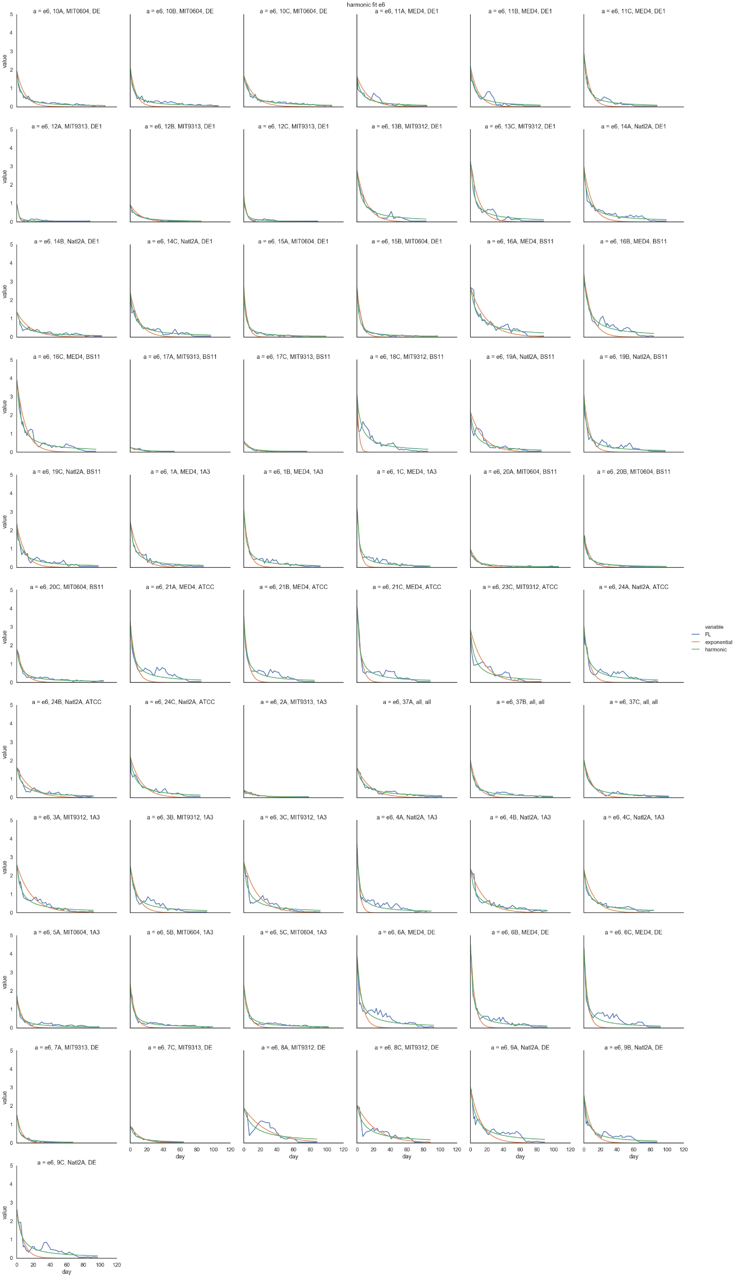
Samples where harmonic fits better

Slide 19
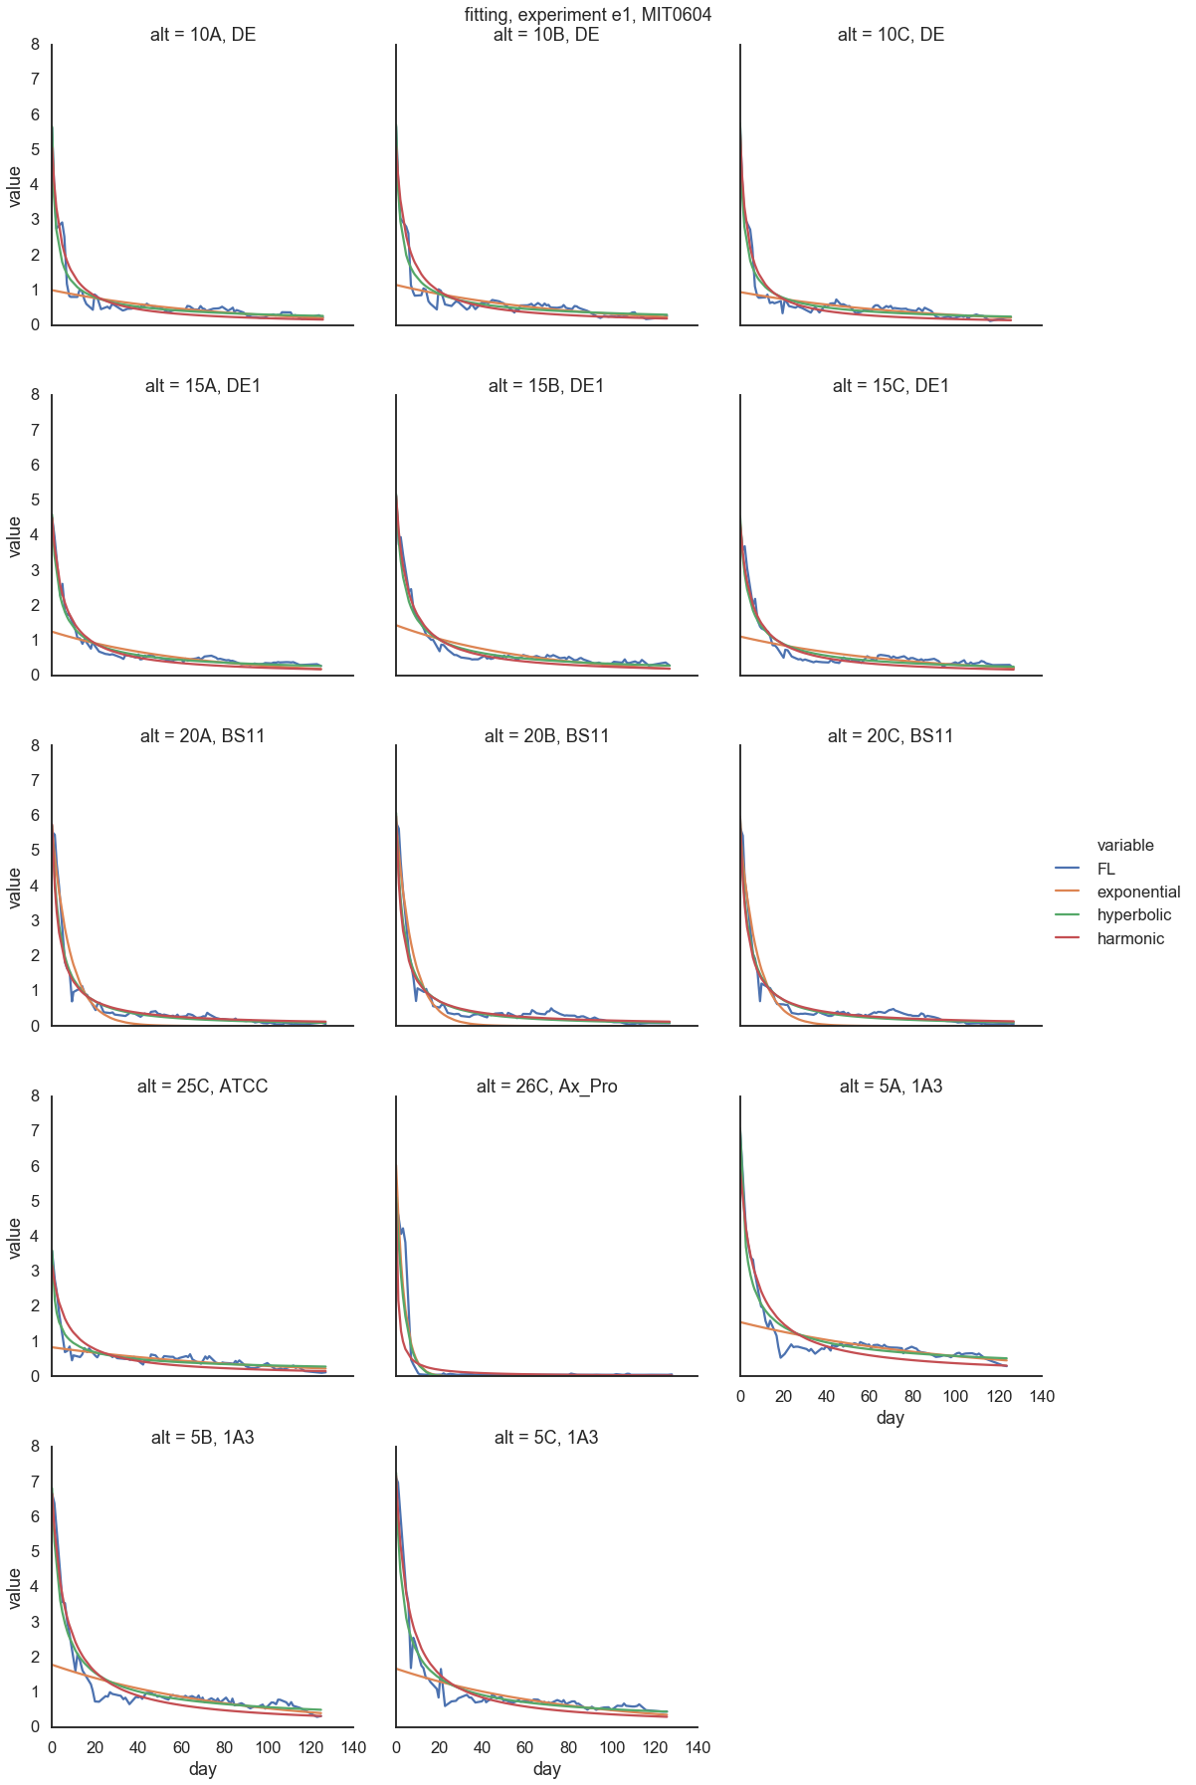
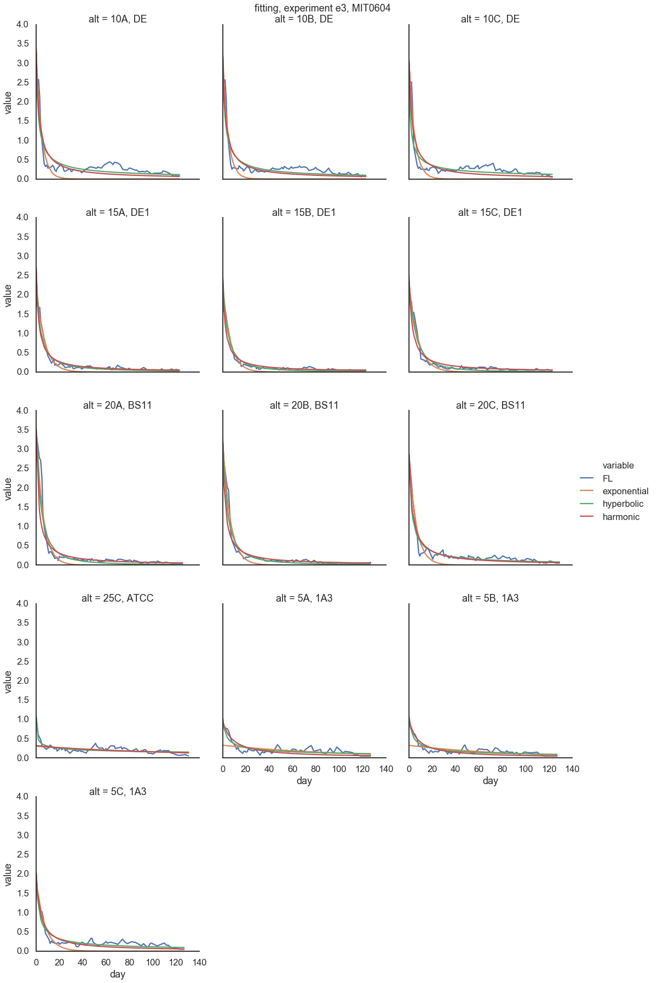
MIT0604

Slide 20
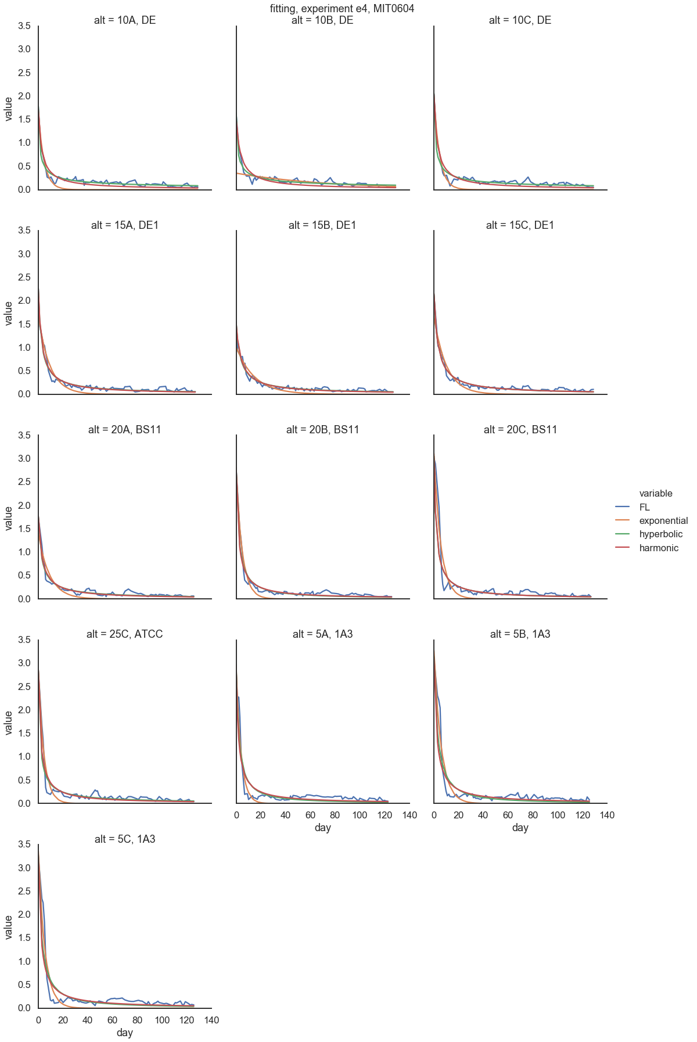
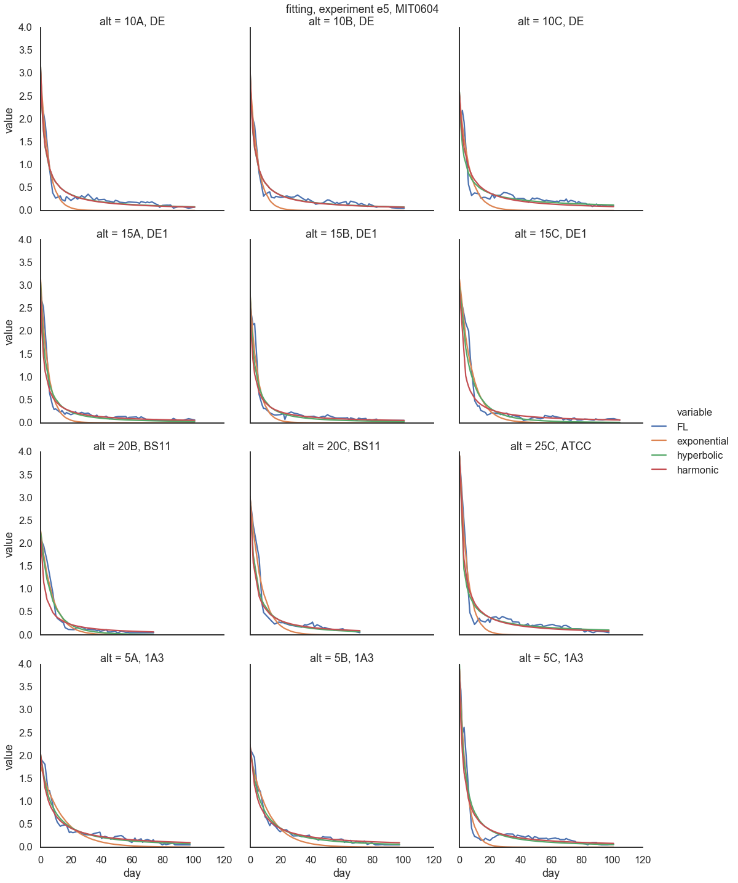
MIT0604

Slide 21
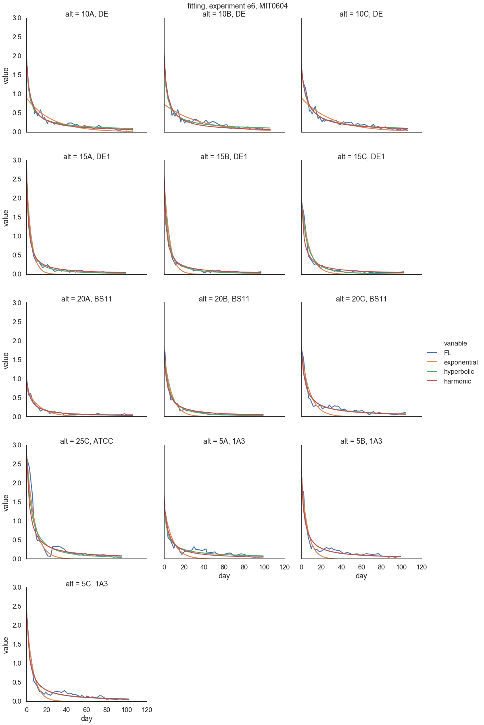
MIT0604

Slide 22
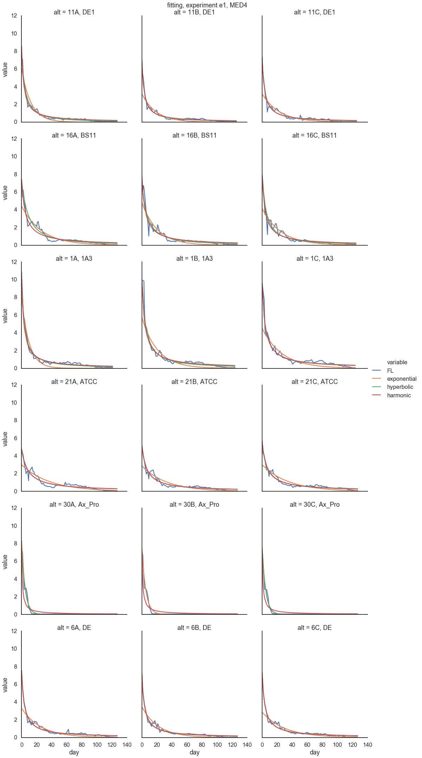
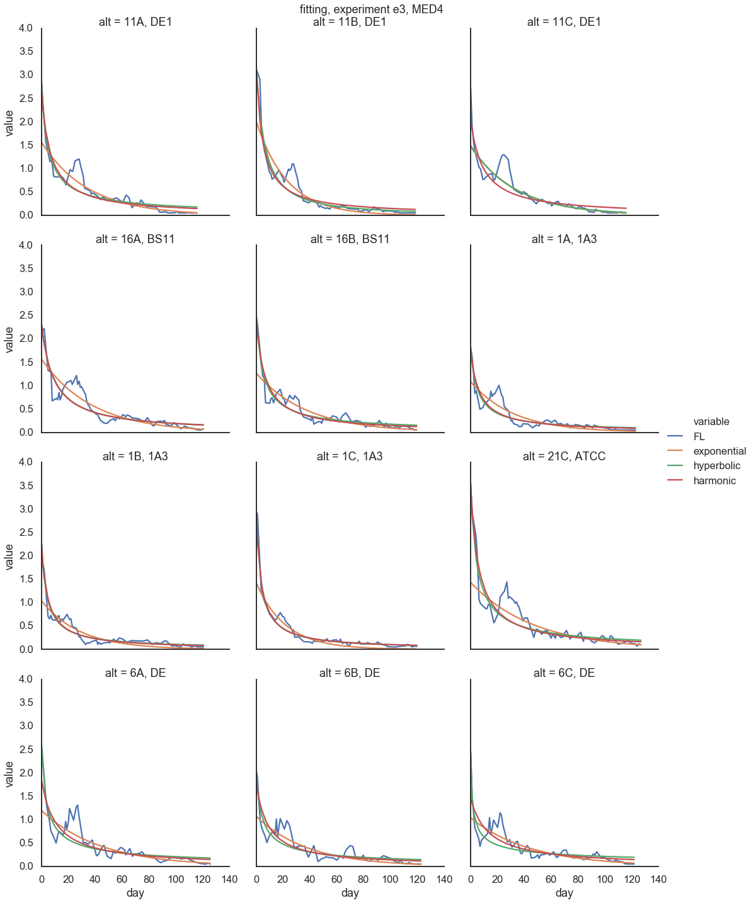
MED4

Slide 23
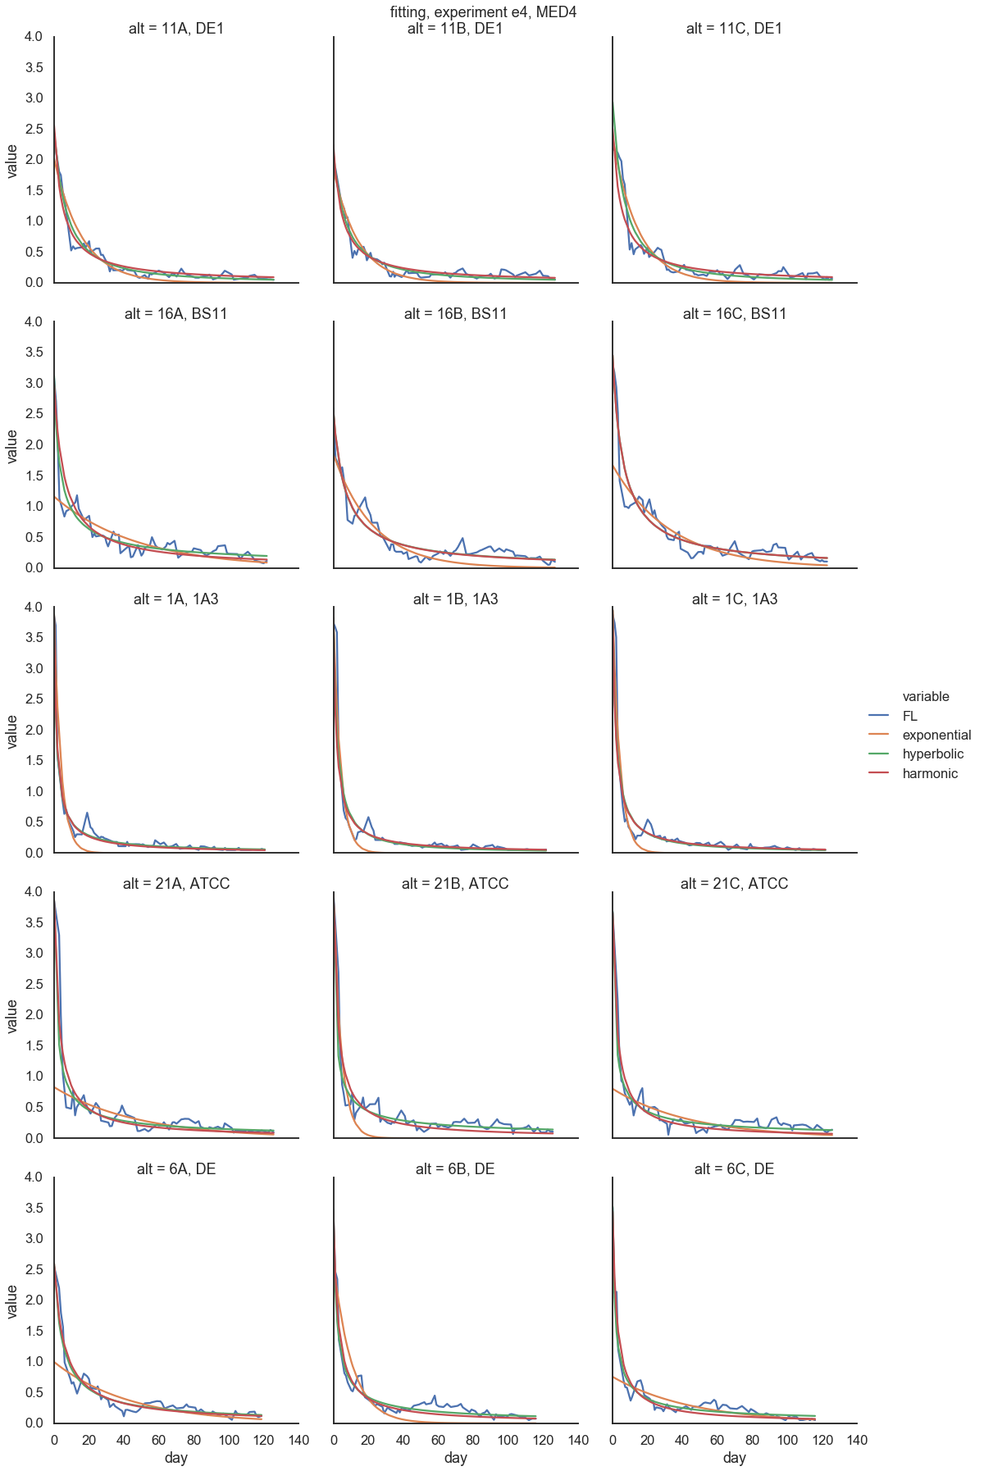
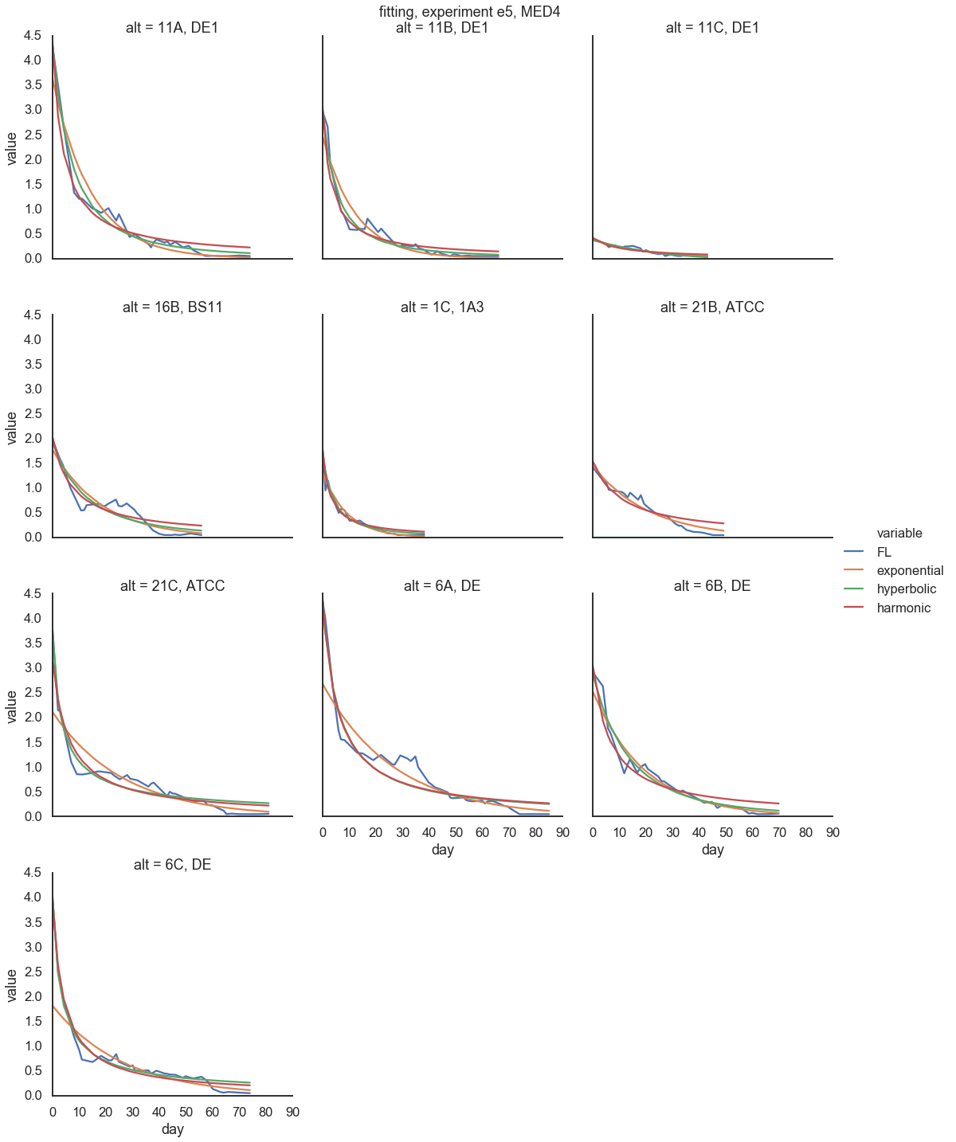
MED4

Slide 24

MED4

Slide 25


MIT9313

Slide 26


MIT9313

Slide 27

MIT9313

Slide 28


MIT9312

Slide 29


MIT9312

Slide 30

MIT9312

Slide 31


Natl2A

Slide 32


Natl2A

Slide 33

Natl2A

Slide 34





All PRO

Slide 35





All

